Slide 1

Artificial Intelligence
Lecture 6: Markov Decision Processes

Slide 2
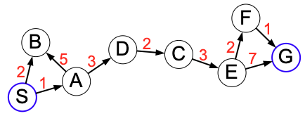
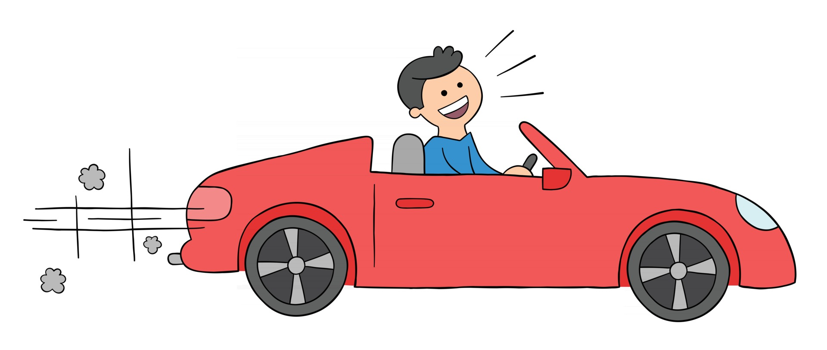
Deterministic Search
deterministic
state s, action a
state Succ(s, a)

Slide 3

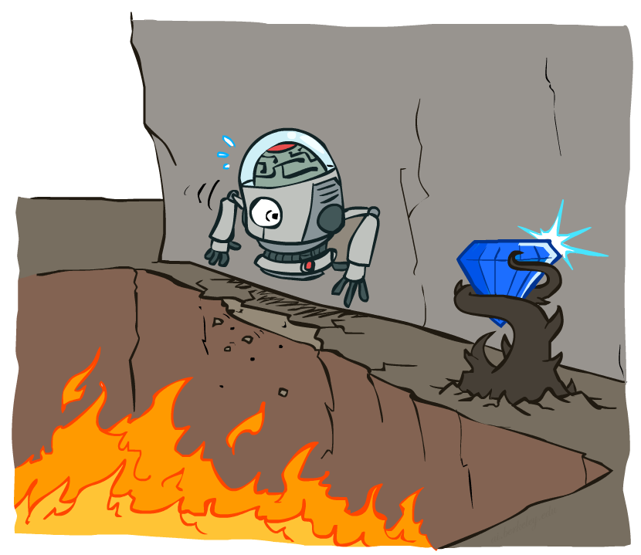
Non-Deterministic Search
state s'
1
state s, action a
random
state s'
2
Uncertainty in the real world

Slide 4





Example: Grid World
A maze-like problem
The agent lives in a grid
Walls block the agent’s path
Noisy movement: actions do not always go as planned
80% of the time, the action North takes the agent North (if there is no wall there)
10% of the time, North takes the agent West; 10% East
If there is a wall in the direction the agent would have been taken, the agent stays put
The agent receives rewards each time step
Small “living” reward each step (can be negative)
Big rewards come at the end (good or bad)
Goal: maximize sum of rewards

Slide 5
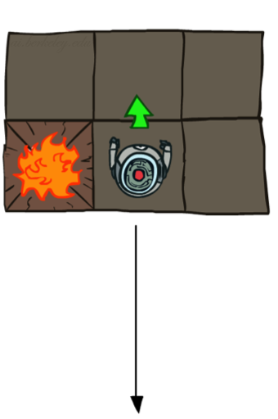
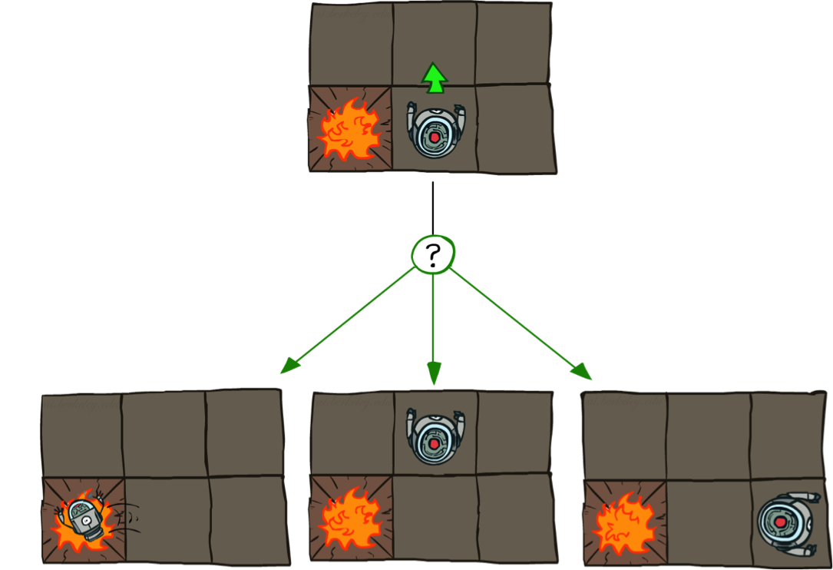

Grid World Actions
Deterministic Grid World
Stochastic Grid World

Slide 6
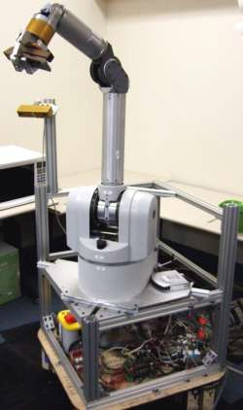


Applications
Robotics: decide where to move, but actuators can fail, hit unseen obstacles, etc.
Resource allocation: decide what to produce, don’t know the customer demand for various products
Agriculture: decide what to weather and thus crop yield
plant,
but don’t know
7

Slide 7
RoadMap
Markov Decision Processes
Policy evaluation
Value iteration

Slide 8

Markov Processes
Definition: Markov process
Markov decision processes formally describe an environment for reinforcement learning
Where the environment is fully observable
i.e. The current state completely characterises the process
Almost all RL problems can be formalised as MDPs, e.g.
Optimal control primarily deals with continuous MDPs
Partially observable problems can be converted into MDPs
Bandits are MDPs with one state

Slide 9

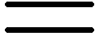
Markov Processes
What is Markov about MDPs?
“Markov” generally means that given the present state, the future and the past are independent
For Markov decision processes, “Markov” means action outcomes depend only on the current state
This is just like search, where the successor function could only depend on the current state (not the history)
The state captures all relevant information from the history
Once the state is known, the history may be thrown away
i.e. The state is a sufficient statistic of the future
Andrey Markov (1856-1922)

Slide 10
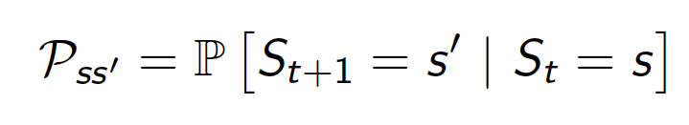
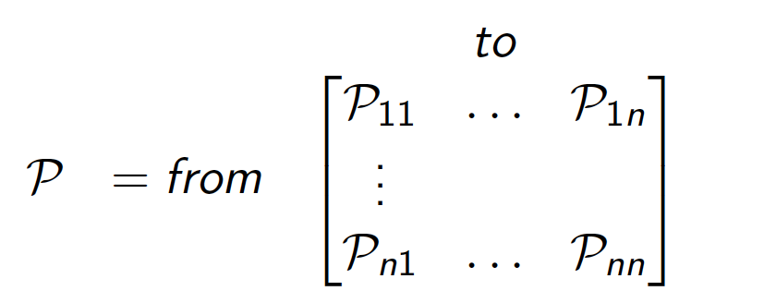
State Transition Matrix
For a Markov state s and successor state s’, the state transition probability is defined by
State transition matrix P defines transition probabilities from all states s to all successor states s’,
Sums to 1

Slide 11
Markov Process
A Markov process is a memoryless random process, i.e. a sequence of random states S₁,S₂,… with the Markov property.
Definition:
A Markov Process is a tuple (S,P)
S is a (finite) set of states
P is a state transition probability matrix,

Slide 12
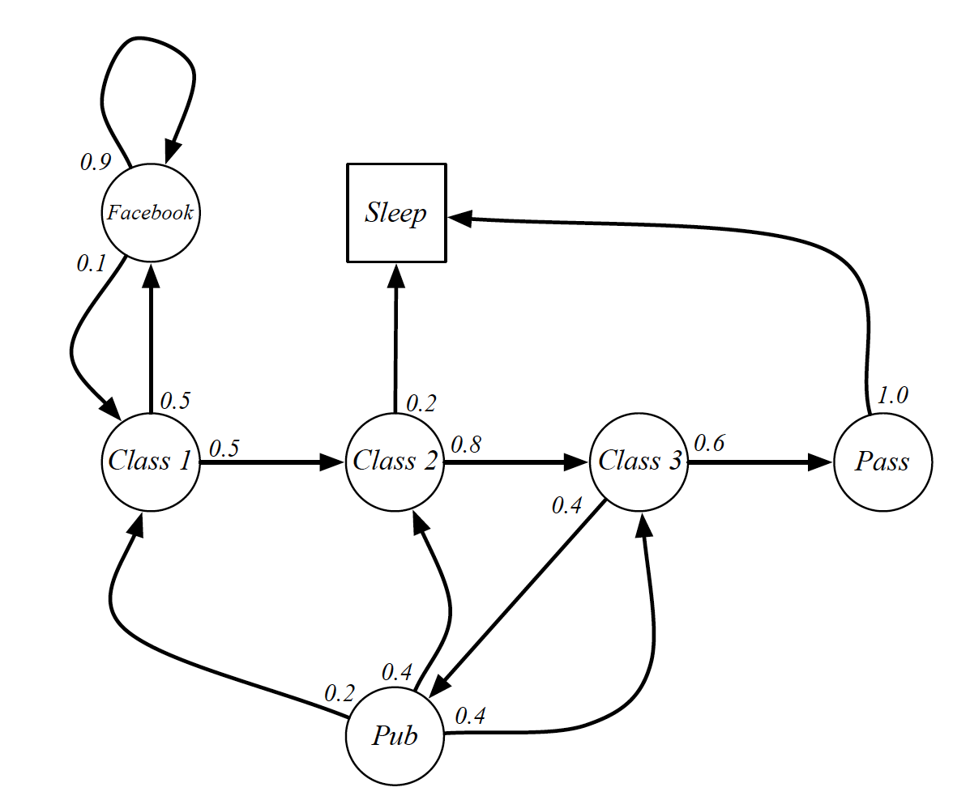
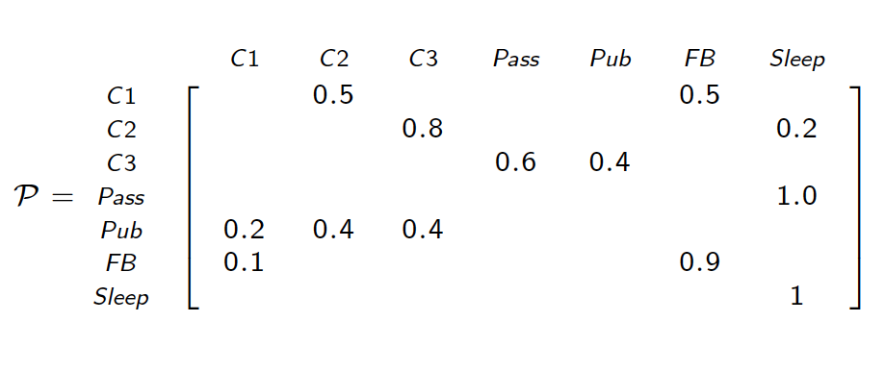
Example
Markov Chain starting from S1 = Class 1
C1 C2 C3 Pass Sleep
C1 FB FB C1 C2 Sleep
C1 C2 C3 Pub C2 C3 Pass Sleep
C1 FB FB C1 C2 C3 Pub C1 FB FB FB C1 C2 C3 Pub C2 Sleep
Markov Chain Transition Matrix

Slide 13
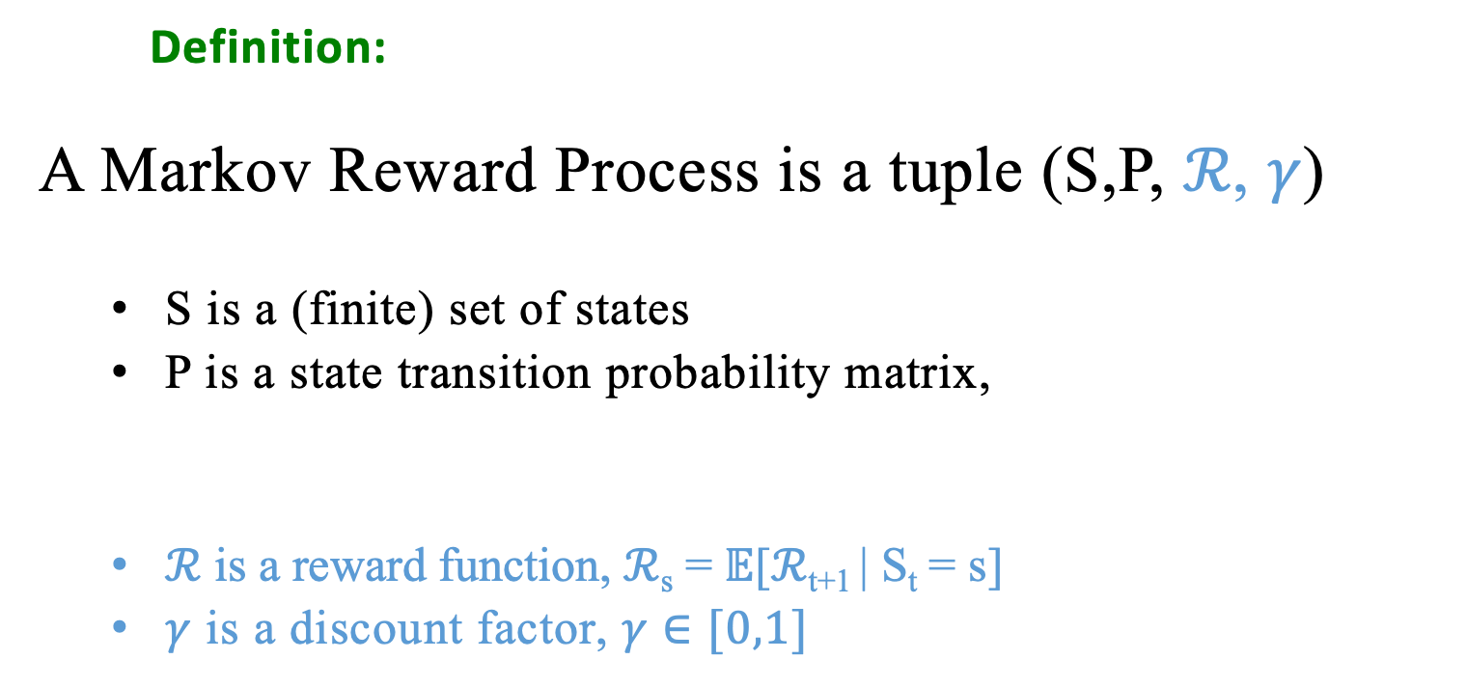
Markov Reward Process
Definition:
A Markov Reward Process is a tuple (S,P, $ℛ$, 𝛾)
S is a (finite) set of states
P is a state transition probability matrix,
$ℛ$ is a reward function, $ℛ$_{s} = $𝔼$[$ℛ$_{t+1} | S_{t} = s]
𝛾 is a discount factor, 𝛾 $∈[0,1]$

Slide 14
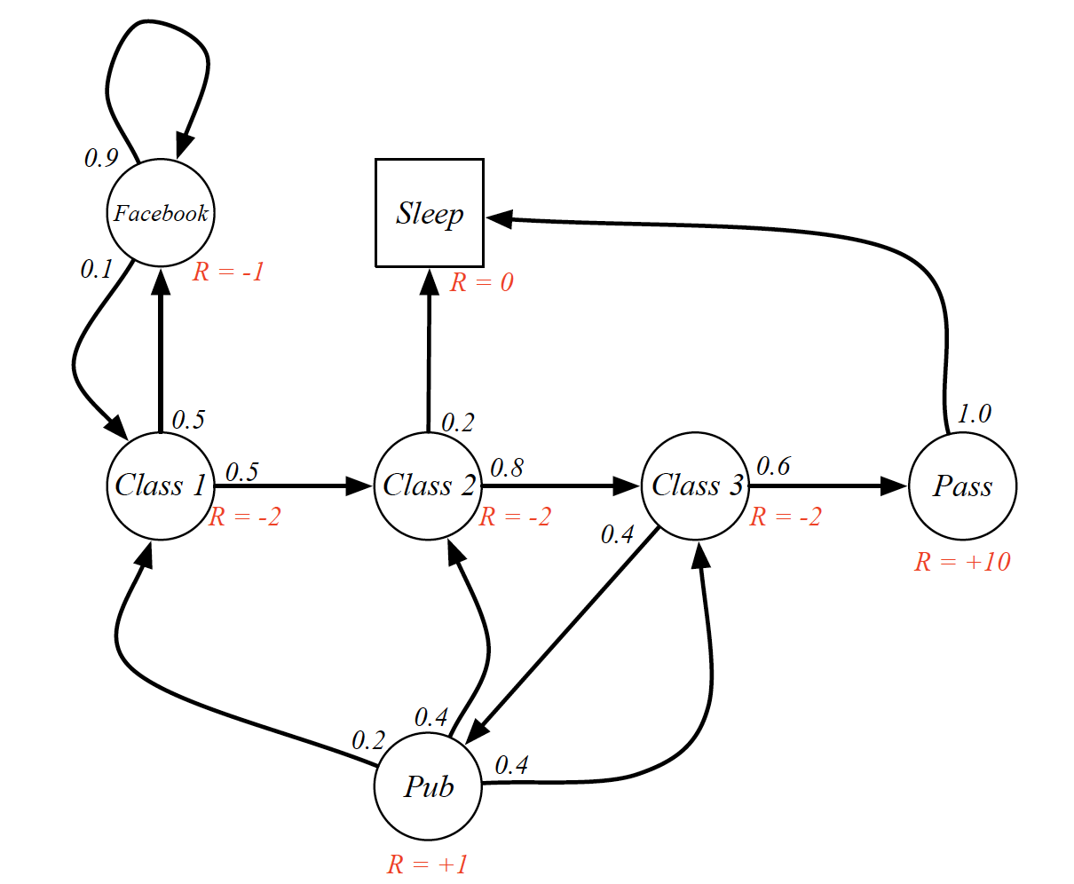
Example

Slide 15
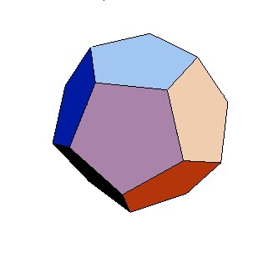
MDP for dice game
Example: dice game
For each round r = 1, 2, . . .
You choose stay or quit.
If quit, you get $10 and we end the game.
If stay, you get $4 and then I roll a 6-sided dice.
If the dice results in 1 or 2, we end the game.
Otherwise, continue to the next round.
in
(2/3): $4
stay
in,stay
quit
(1/3): $4
in,quit
1: $10
end

Slide 16
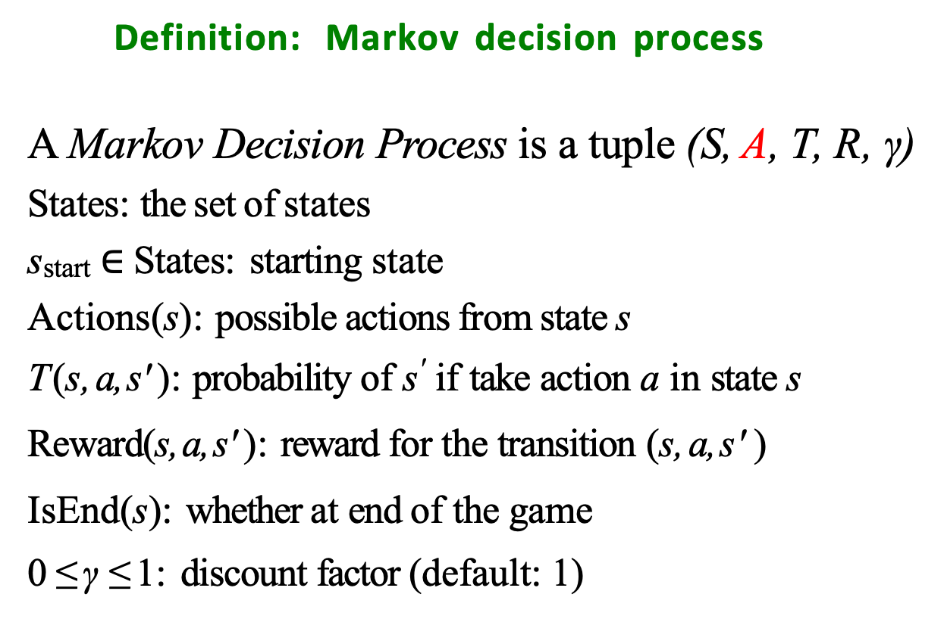
Markov decision process
Definition: Markov decision process
A Markov Decision Process is a tuple (S, A, T, R, γ)
States: the set of states
s_{start} $∈$ States: starting state
Actions(s): possible actions from state s
T (s, a, s' ): probability of s' if take action a in state s
Reward(s, a, s' ): reward for the transition (s, a, s' )
IsEnd(s): whether at end of the game
0 ≤ γ ≤ 1: discount factor (default: 1)
Andrey Markov (1856-1922)

Slide 17
Search problems
Definition: search problem
States: the set of states
s_{start} ∈ States: starting state
Actions(s): possible actions from state s
Succ(s, a): where we end up if take action a in state s Cost(s, a): cost for taking action a in state s IsEnd(s): whether at end
Succ(s, a) ⇒ T (s, a, s' )
Cost(s, a) ⇒ Reward(s, a, s')

Slide 18
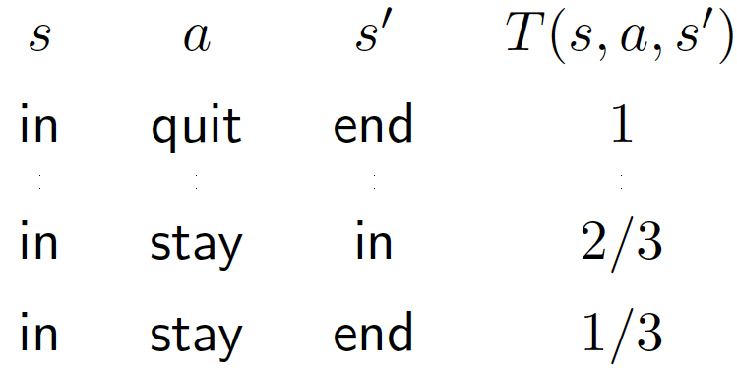
Transitions
Definition: transition probabilities
The transition probabilities T (s, a, s' ) specify the probability of ending up in state s' if taken action a in state s.
Example: transition probabilities
in
(2/3): $4
stay
in,stay
quit
(1/3): $4
in,quit
1: $10
end

Slide 19
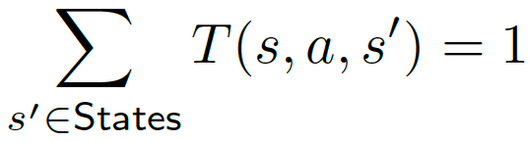
Probabilities sum to one
Example: transition probabilities
For each state s and action a:
Successors: s' such that T (s, a, s') > 0

Slide 20
Transportation example
Example: transportation
Street with blocks numbered 1 to n. Walking from s to s + 1 takes 1 minute.
Taking a magic tram from s to 2s takes 2 minutes. How to travel from 1 to n in the least time?
Tram fails with probability 0.5.
Notes:
I want to find out the optimal path to solve this problem

Slide 21

Solution or optimal path?
Search problem: In deterministic single-agent search problems, we wanted an optimal plan, or sequence of actions, from start to a goal.
MDP:
Definition: Policy
A policy π is a mapping from each state s ∈ States to an action a ∈ Actions(s).
A policy fully defines the behaviour of an agent
MDP policies depend on the current state (not the history)
For MDPs, we want an optimal policy π*: S → A
A policy π gives an action for each state
An optimal policy is one that maximizes expected utility if followed
Notes:
We define solution here using notion policy.

Slide 22
Optimal Policies
R(s) = -0.01
R(s) = -0.03
R(s) = -0.4
R(s) = -2.0

Slide 23
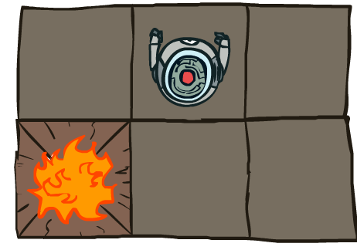


MDP Search Trees
s
s is a state
a
(s, a) is a q-state
s, a
(s,a,s’) called a transition or response from world
T(s,a,s’) = P(s’|s,a)
R(s,a,s’)
s,a,s’
s’
s’ is picked by environment or world

Slide 24
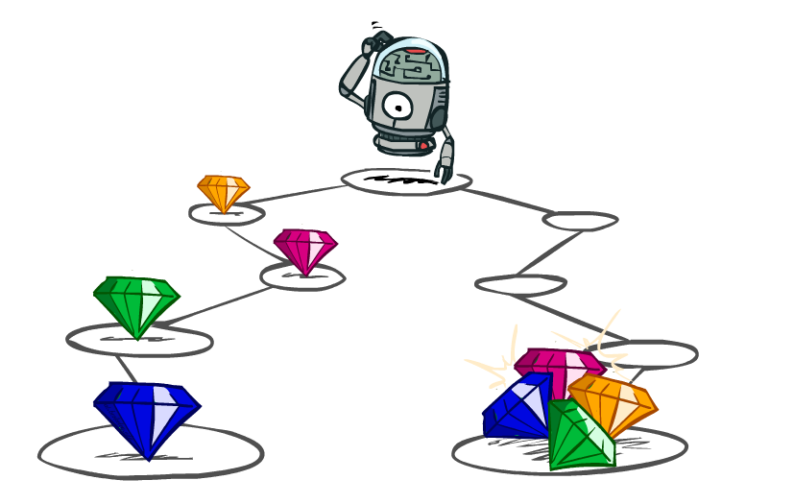
Utilities of Sequences
What preferences should an agent have over reward sequences?
More or less?
Now or later?
[1, 2, 2]
or
[2, 3, 4]
[0, 0, 1]
or
[1, 0, 0]

Slide 25
Evaluating a policy
Definition: Utility
Following a policy yields a random path.
The utility of a policy is the (discounted) sum of the rewards on the path (this is a random quantity).
Path Utility
[in; stay, 4, end] 4
[in; stay, 4, in; stay, 4, in; stay, 4, end] ?
[in; stay, 4, in; stay, 4, end] ?
[in; stay, 4, in; stay, 4, in; stay, 4, in; stay, 4, end] ?
... ...
Definition: value (expected utility)
The value of a policy is the expected utility.

Slide 26
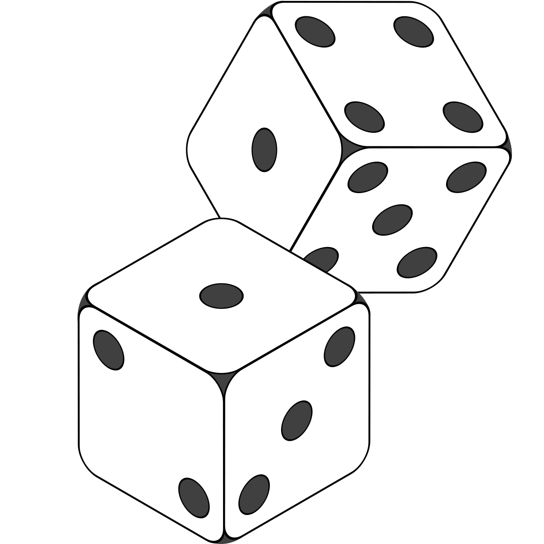

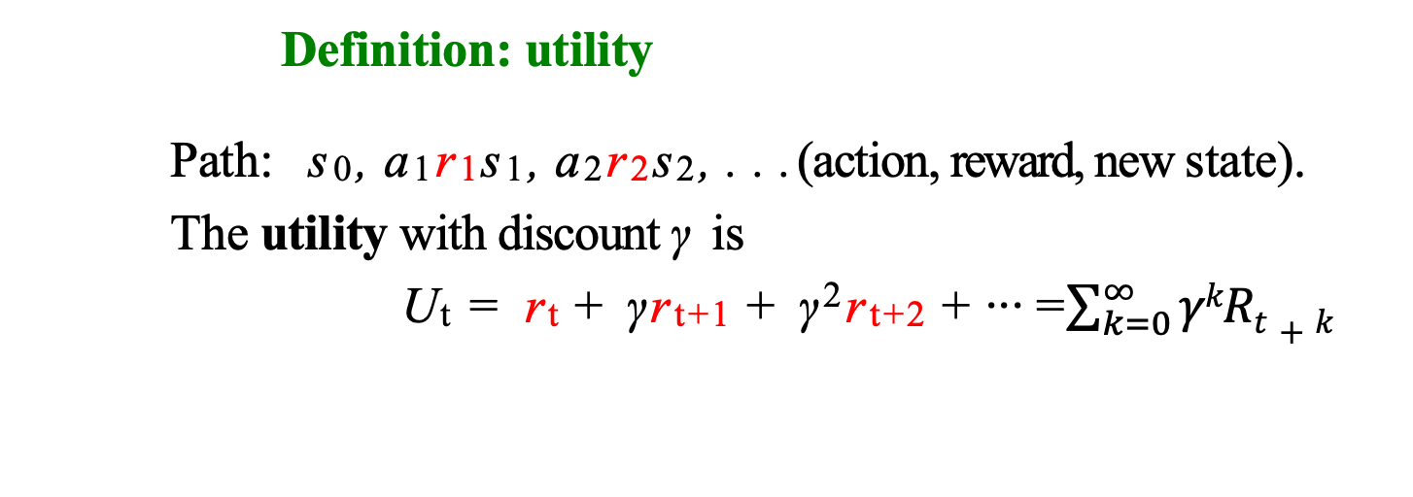



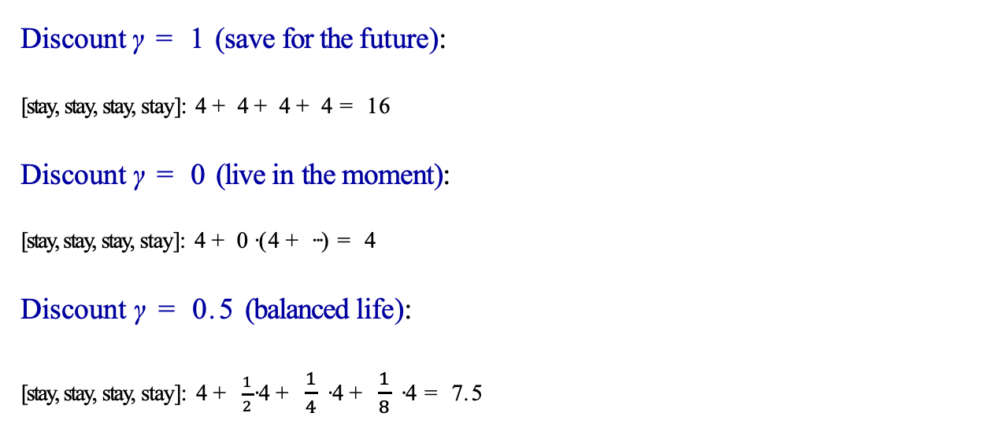
Discount
Definition: utility
Path: s₀, a₁r₁s₁, a₂r₂s₂, . . . (action, reward, new state).
The utility with discount γ is
U_{t} = r_{t} + γr_{t+1} + γ²r_{t+2} +· · · =$\sum_{k=0}^{∞}{γkRt+k}$
Discount γ = 1 (save for the future):
[stay, stay, stay, stay]: 4 + 4 + 4 + 4 = 16
Discount γ = 0 (live in the moment):
[stay, stay, stay, stay]: 4 + 0 · (4 + · · · ) = 4
Discount γ = 0.5 (balanced life):
[stay, stay, stay, stay]: 4 + $\frac{1}{2}$· 4 + $\frac{1}{4}$ · 4 + $\frac{1}{8}$ · 4 = 7.5
Worth Now
Worth Next Step
Worth In Two Steps

Slide 27

Discount
How to discount?
Each time we descend a level, we multiply in the discount once
Why discount?
Sooner rewards probably do have higher utility than later rewards
Also helps our algorithms converge
Example: discount of 0.5
U([1,2,3]) = ?
U([1,2,3]) = 1*1 + 0.5*2 + 0.25*3
U([3,2,1]) = ?
U([1,2,3]) < U([3,2,1])

Slide 28
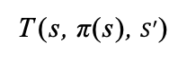
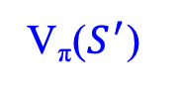
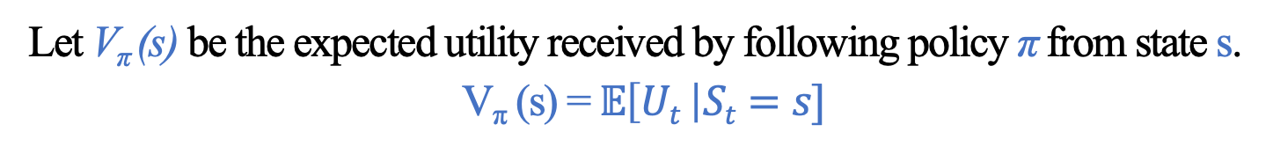
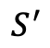
Policy evaluation
Definition: value of a policy
Let V_{π} (s) be the expected utility received by following policy π from state s.
V_{π} (s) = $𝔼\left[Ut \right|St=s]$
Definition: Q-value of a policy
Let Q_{π} (s, a) be the expected utility of taking action a from state s, and then following policy π.
Q_{π} (s, π(s))
$$S^{′}$$
V_{π}($S^{′}$)
T (s, π(s), $S^{′}$)
V_{π} (s)
s
π(s)
s, π(s)

Slide 29
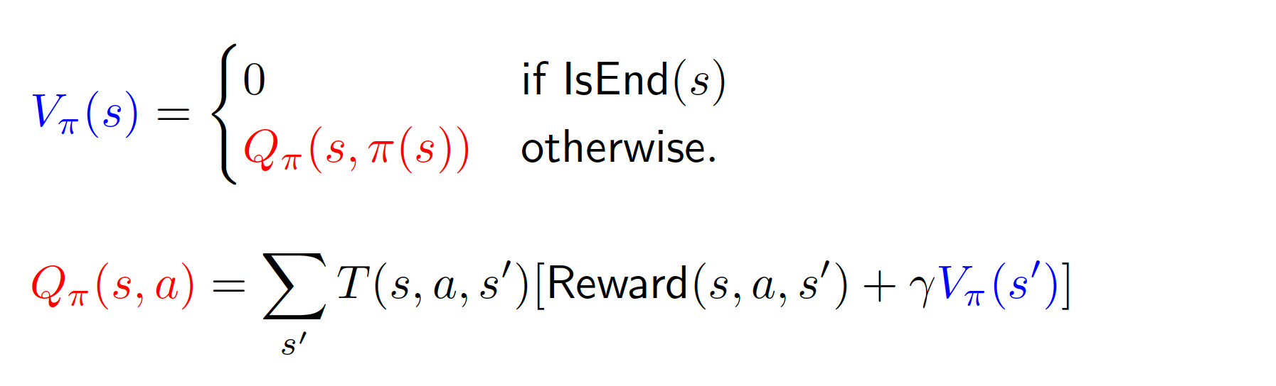
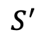
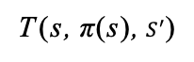
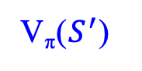
Policy evaluation
Plan: define recurrences relating value and Q-value
Q_{π} (s, π(s))
$$S^{′}$$
V_{π}($S^{′}$)
T (s, π(s), $S^{′}$)
V_{π} (s)
s
π(s)
s, π(s)

Slide 30
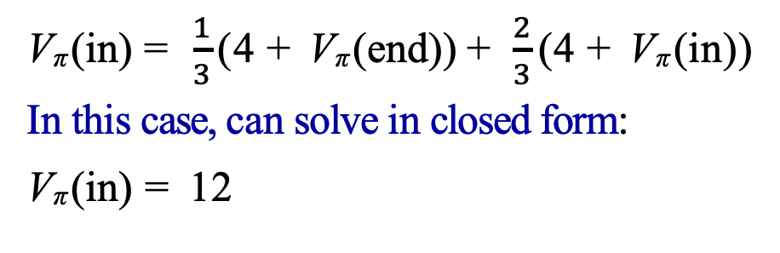
Dice game
in
(2/3): $4
stay
in,stay
quit
(1/3): $4
in,quit
1: $10
end
V_{π} (in) = $\frac{1}{3}$ (4 + V_{π} (end)) + $\frac{2}{3}$ (4 + V_{π} (in))
In this case, can solve in closed form:
V_{π} (in) = 12
Let π be the “stay” policy: π(in) = stay.
V_{π} (end) = 0
V_{π} (in) = Q_{π} (in, stay)

Slide 31

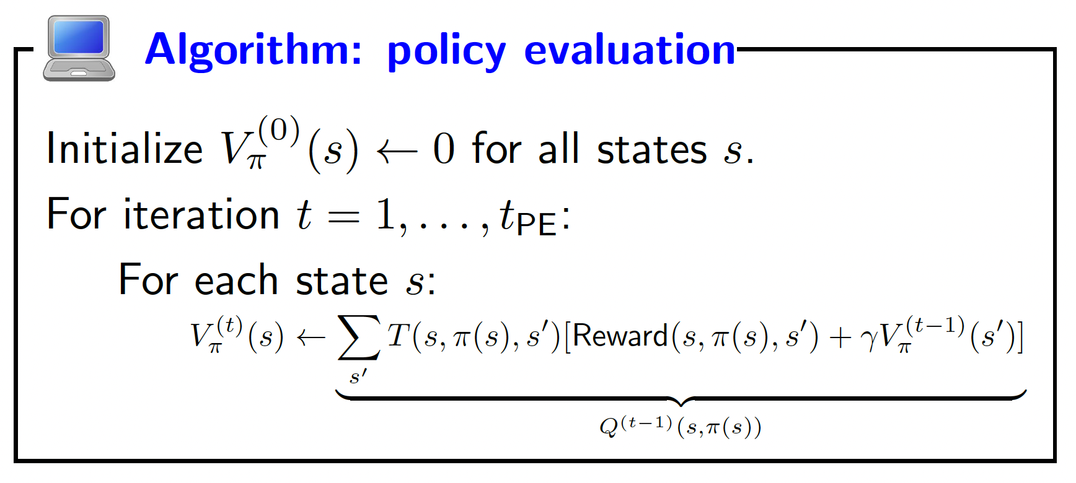
Policy evaluation
Key idea: iterative algorithm
Start with arbitrary policy values and repeatedly apply recurrences to converge to true values.

Slide 32
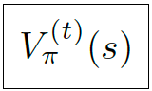
Policy evaluation computation
iteration t
0 | -0.1 | -0.2 | 0.7 | 1.1 | 1.6 | 1.9 | 2.2 | 2.4 | 2.6
0 | -0.1 | 1.8 | 1.8 | 2.2 | 2.4 | 2.7 | 2.8 | 3 | 3.1
0 | 4 | 4 | 4 | 4 | 4 | 4 | 4 | 4 | 4
0 | -0.1 | 1.8 | 1.8 | 2.2 | 2.4 | 2.7 | 2.8 | 3 | 3.1
0 | -0.1 | -0.2 | 0.7 | 1.1 | 1.6 | 1.9 | 2.2 | 2.4 | 2.6
state s

Slide 33
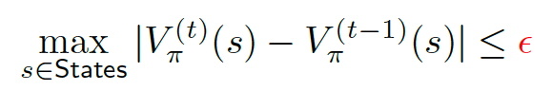
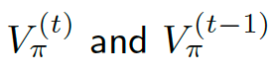
Policy evaluation implementation
How many iterations (t_{PE}) ? Repeat until values don’t change much:
Don’t store V$π$^{(t)} for each iteration t, need only last two:

Slide 34
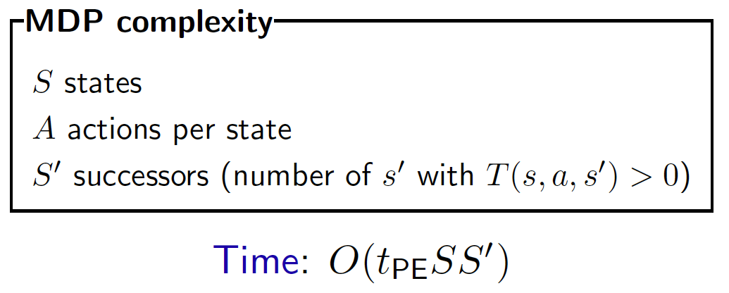
Complexity

Slide 35
Optimal Quantities
The value (utility) of a state s:
V*(s) = expected utility starting in s and acting optimally
The value (utility) of a q-state (s,a):
Q*(s,a) = expected utility starting out having taken action a from state s and (thereafter) acting optimally
The optimal policy:
π*(s) = optimal action from state s
s
s is a state
a
(s, a) is a q-state
s, a
s,a,s’
(s,a,s’) is a transition
s’

Slide 36

Optimal Quantities
How to be optimal:
Step 1: Take correct first action
Step 2: Keep being optimal
Bellman Equations

Slide 37

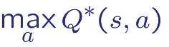
Optimal value and Q-value
Goal: try to get directly at maximum expected utility
Definition: optimal value
The optimal value V *(s) is the maximum value attained by any policy.
Q*(s, a)
s
a
s, a
T (s, a, s’ )
_{S}’
V*(s’ )
s, a
a
V*(s)
s
s,a,s’
s’
Optimal value if take action a in state s:
Optimal value from state s:
0
If IsEnd(s)
V*(s )=
Otherwise

Slide 38
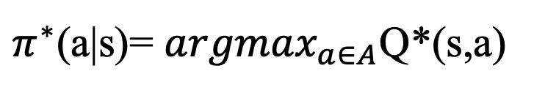
Optimal policy
Q *(s, a)
s, a
T (s, a, s')
_{S}’
V*(s')
a
V*(s)
s
Given Q* read off the optimal policy
$π^{∗}$(a|s)= ${argmax}_{a∈A}$Q*(s,a)

Slide 39
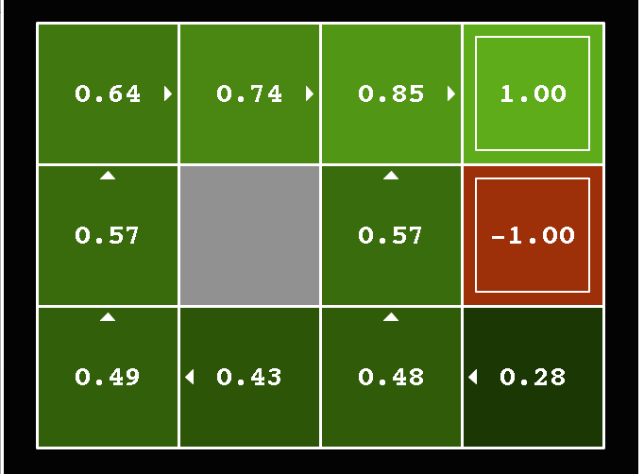
Grid World: optimal V Values
Noise = 0.2
Discount = 0.9
Living reward = 0

Slide 40
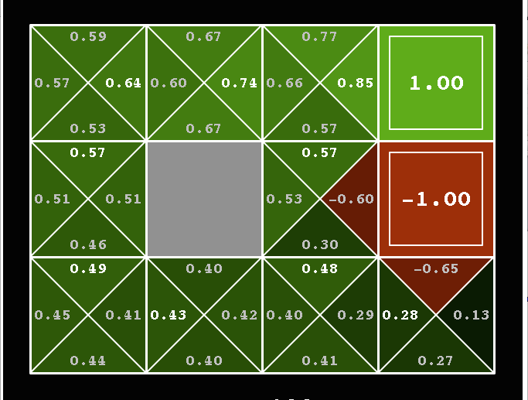
Grid World: optimal Q Values
Noise = 0.2
Discount = 0.9
Living reward = 0

Slide 41
Value iteration
Bellman equations characterize the optimal values:
Value iteration computes them:
Value iteration is just a fixed point solution method
V(s)
a
s, a
s,a,s’
V(s’)

Slide 42

Value iteration
Algorithm: value iteration [Bellman, 1957]
V_{k+1}(s)
Initialize V *₀(s) ← 0 for all states s.
a
For iteration k = 0,1, . . . , k_{vi}:
For each state s:
s, a
s,a,s’
V_{k}(s’)
Q
*
(s,a)
k
Complexity: O(k_{vi}SAS')

Slide 43
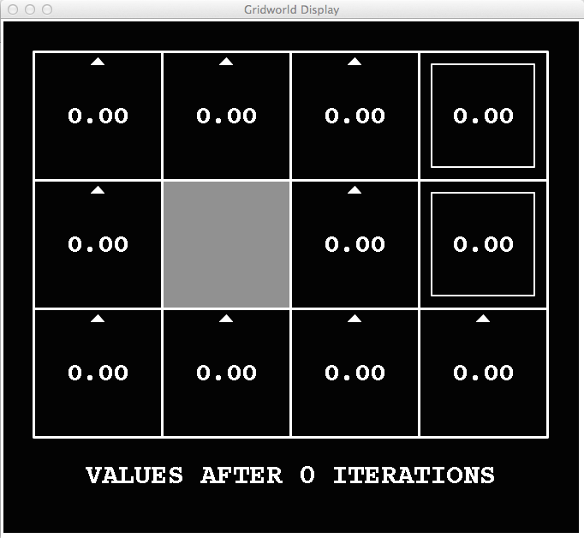
k=0
Noise = 0.2
Discount = 0.9
Living reward = 0
Notes:
Assuming zero living reward

Slide 44
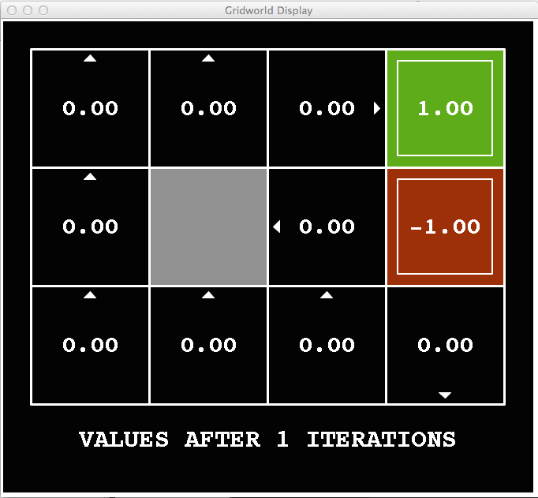
k=1
Noise = 0.2
Discount = 0.9
Living reward = 0

Slide 45
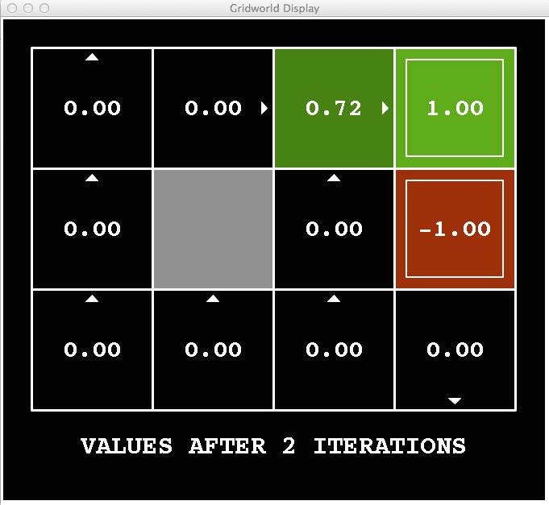
k=2
Optimal action will be “right”
Noise = 0.2
Discount = 0.9
Living reward = 0
V₂(3,3) ← 0.8 [0+0.9x1] + 0.1[0+0.9x0] + 0.1[0+0.9x0] = 0.72

Slide 46
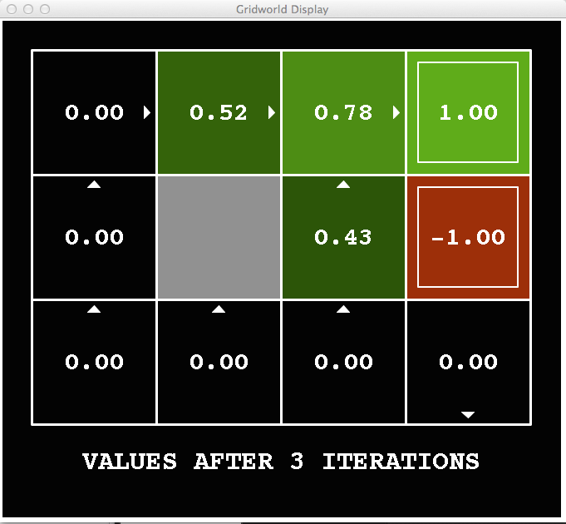
k=3
Noise = 0.2
Discount = 0.9
Living reward = 0
Notes:
Rewards are distributed and propagate from there

Slide 47
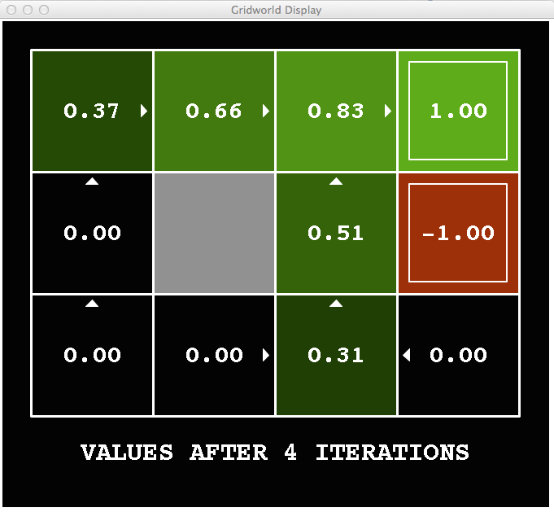
k=4
Noise = 0.2
Discount = 0.9
Living reward = 0
Notes:
Assuming zero living reward

Slide 48
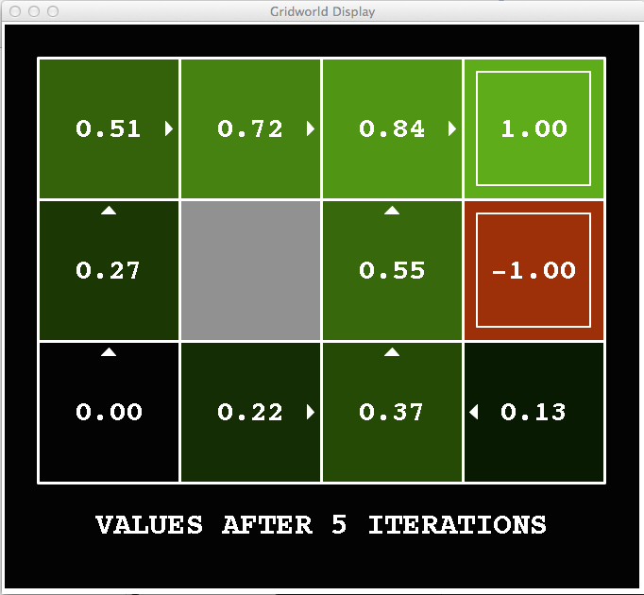
k=5
Noise = 0.2
Discount = 0.9
Living reward = 0
Notes:
Assuming zero living reward

Slide 49
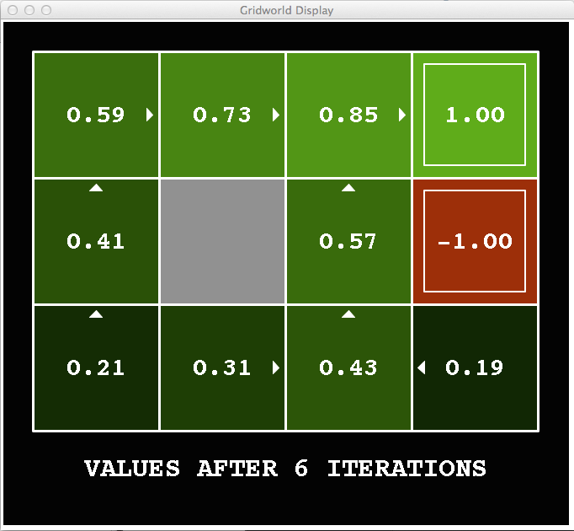
k=6
Noise = 0.2
Discount = 0.9
Living reward = 0
Notes:
Assuming zero living reward

Slide 50
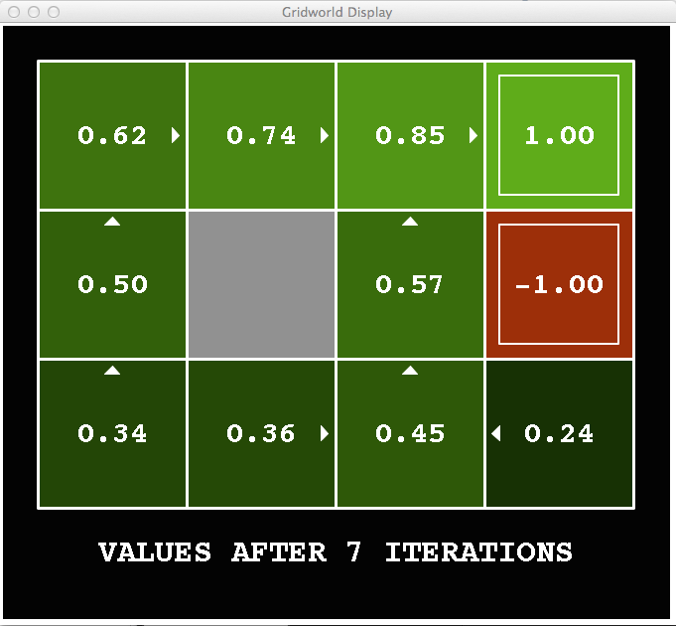
k=7
Noise = 0.2
Discount = 0.9
Living reward = 0
Notes:
Assuming zero living reward

Slide 51
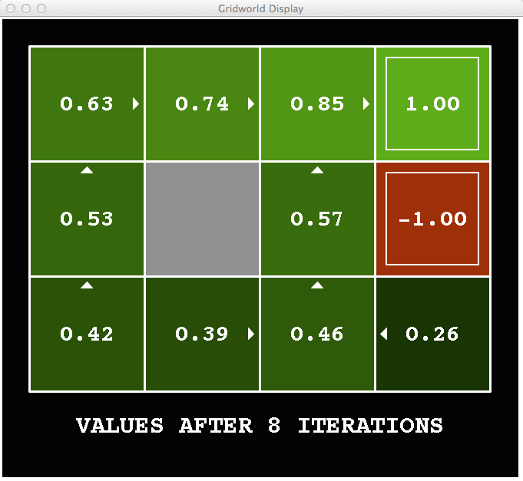
k=8
Noise = 0.2
Discount = 0.9
Living reward = 0
Notes:
Assuming zero living reward

Slide 52
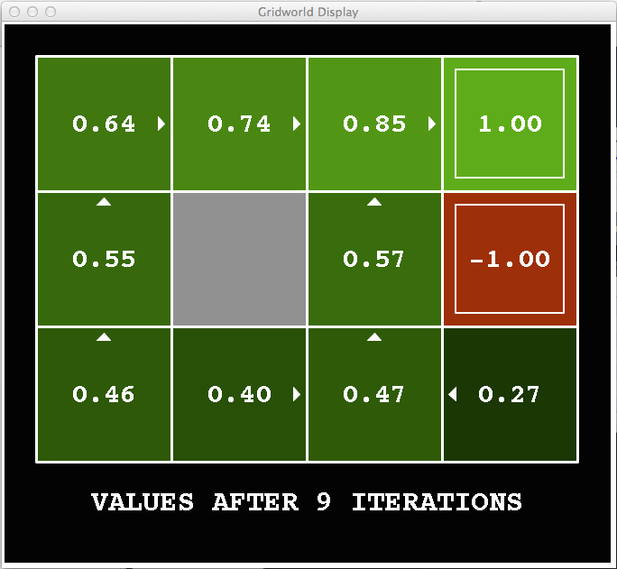
k=9
Noise = 0.2
Discount = 0.9
Living reward = 0
Notes:
Assuming zero living reward

Slide 53

k=10
Noise = 0.2
Discount = 0.9
Living reward = 0
Notes:
Assuming zero living reward

Slide 54

k=11
Noise = 0.2
Discount = 0.9
Living reward = 0
Notes:
Assuming zero living reward

Slide 55

k=12
Noise = 0.2
Discount = 0.9
Living reward = 0
Notes:
Assuming zero living reward

Slide 56

k=100
Noise = 0.2
Discount = 0.9
Living reward = 0

Slide 57
Problems with Value Iteration
Value iteration repeats the Bellman updates:
Problem 1: It’s slow – O(S²A) per iteration
Problem 2: The “max” at each state rarely changes
Problem 3: The policy often converges long before the values
s
a
s, a
s,a,s’
s’

Slide 58
Policy Iteration
Alternative approach for optimal values:
Step 1: Policy evaluation: calculate utilities for some fixed policy (not optimal utilities!) until convergence
Step 2: Policy improvement: update policy using one-step look-ahead with resulting converged (but not optimal!) utilities as future values
Repeat steps until policy converges
This is policy iteration
It’s still optimal!
Can converge (much) faster under some conditions

Slide 59


Example: Policy Evaluation
Always Go Right
Always Go Forward

Slide 60


Example: Policy Evaluation
Always Go Right
Always Go Forward

Slide 61
Policy Iteration
Evaluation: For fixed current policy π, find values with policy evaluation:
Iterate until values converge:
Improvement: For fixed values, get a better policy using policy extraction
One-step look-ahead:

Slide 62
Fixed Policies
Do the optimal action
Do what π says to do
s
s
a
π(s)
s, a
s, π(s)
s,a,s’
s, π(s),s’
s’
s’
If we fixed some policy π(s), then the tree would be simpler – only one action per state

Slide 63

Policy Evaluation
How do we calculate the V’s for a fixed policy π?
Idea 1: Turn recursive Bellman equations into updates
(like value iteration)
Efficiency: O(S²) per iteration
Idea 2: Without the maxes, the Bellman equations are just a linear system
s
π(s)
s, π(s)
s, π(s),s’
s’

Slide 64
Comparison
Both value iteration and policy iteration compute the same thing (all optimal values)
In value iteration:
Every iteration updates both the values and (implicitly) the policy
We don’t track the policy, but taking the max over actions implicitly recomputes it
In policy iteration:
We do several passes that update utilities with fixed policy (each pass is fast because we consider only one action, not all of them)
After the policy is evaluated, a new policy is chosen (slow like a value iteration pass)
The new policy will be better (or we’re done)
Both are dynamic programs for solving MDPs

Slide 65
Summary: MDP Algorithms
So you want to….
Compute optimal values: use value iteration or policy iteration
Compute values for a particular policy: use policy evaluation
Turn your values into a policy: use policy extraction (one-step look ahead)
These all look the same!
They basically are – they are all variations of Bellman updates
They differ only in whether we plug in a fixed policy or max over actions

Slide 66

Summary
Markov decision processes (MDPs) cope with uncertainty
Solutions are policies rather than paths
Policy evaluation computes policy value (expected utility)
Value iteration computes optimal value (maximum expected utility) and optimal policy
Main technique: write recurrences → algorithm
Next time: reinforcement learning — when we don’t know rewards, transition probabilities
76

